Slide 1
A Call to Action
Module 1
Administrator/Leadership Teams, Boards of Trustees,
& Community Members
One of a series of professional development modules developed by the Texas Association of School Administrators
Notes:
This module is designed as a two-hour dialogue session with the goals of:
Reflecting on the current state of education in Texas and the U.S.
Comparing the current state with, and the imperative for, future-ready learning transformation
Providing a brief historical context and rationale for change
Discussing the need for and identifying possible areas of transformation
Setting the context for the next steps in transformation and for a deep study of Creating a New Vision for Public Education in Texas
Note: This module could be expanded to a half-day retreat (depending upon the needs of the district). Group engagement tasks at the the end of the presentation require longer-term planning, which could begin with an extended session as part of a visioning and planning process. There is also an optional video providing background data on demographic changes in Texas which could be used in an extended session.

Slide 2
REFLECTION
Think about the last time you were in school as a student…
What was “schooling” like?
How did you experience your average day?
What has changed in the world since then?
How well have our schools responded to these changes?
How do our students today experience an average school day?
Notes:
Allow participants to share their school experiences–”Think about the last time you were in school as a student.”
Click to reveal the second question… “What has changed in the world since then? Allow participants to discuss, making the point clear that the world (global economy, workplace, digital environment, etc.) has changed significantly, but the school experience has not transformed to keep pace with the changed environment and expectations.
Explain to participants that they’ll further examine this issue of educational status quo in a rapidly changing context through watching and discussing two short videos. If the session is to be extended beyond the 2 hours, participants could review and discuss the optional texts:
Fastest Growing Occupations. U.S. Bureau of Labor Statistics (2014)
The Ever-Increasing Burden on America’s Public Schools (J. Vollmer, 2011)
IBM Six-Year High School. Time Magazine article from Feb. 24, 2014
Then click to next slide.
(15 minutes)

Slide 3
Session Agenda
Reflect on the current state of education
Why do we need a new vision for education?
What are our highest hopes for our students?
What type of future do we want for them?
Discuss the context for change
Why transformation now?
What is keeping transformation from occurring?
Develop a vision for the future
How well is our district preparing students to be future-ready?
What steps must our district take to prepare our students for their future?
3
Notes:
Briefly review agenda to develop shared understanding of the expectations of the session.

Slide 4
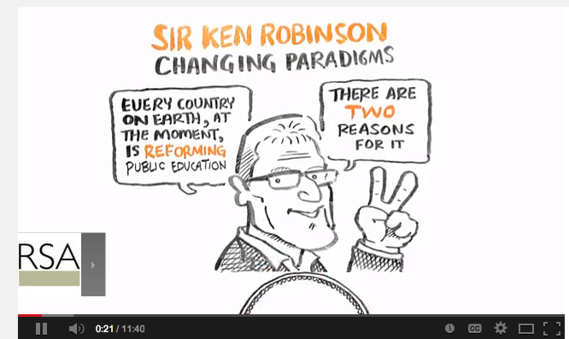
Starting the Discussion
Sir Ken Robinson– Changing Paradigms (video)
https://www.youtube.com/watch?v=zDZFcDGpL4U
Reflection Questions:
What are your highest hopes for our students?
What type of future do you want for them?
Why do we need a new vision for education?
4
Notes:
Why transform?
This video reflection task is designed to provide the context for educational transformation. The session facilitator may choose to show one or both videos, depending upon time constraints and the context/needs of the district. It is important that the facilitator preview both videos to determine their appropriateness for the district.
Show videos and allow time for discussion. Using the reflection questions, debrief participants reflections and thoughts. This conversation should serve to set the context for the transformation discussion to follow.
(30 minutes—11-minute Sir Ken Robinson video, 3-minute Active Learner video, 16-minute discussion)

Slide 5
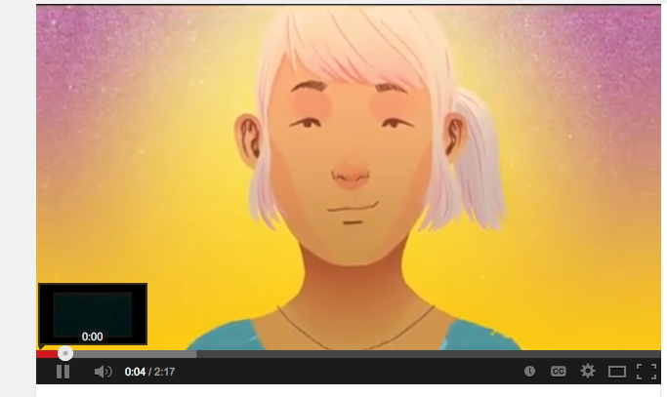
Starting the Discussion
The Voice of the Active Learner (video)
https://www.youtube.com/watch?v=CZ5Vy9BgSeY
Reflection Questions:
What are your highest hopes for our students?
What type of future do you want for them?
Why do we need a new vision for education?
5
Notes:
These notes are a repeat of Slide 4 notes:
Why transform?
This video reflection task is designed to provide the context for educational transformation. The session facilitator may choose to show one or both videos, depending upon time constraints and the context/needs of the district. It is important that the facilitator preview both videos to determine their appropriateness for the district.
Show videos and allow time for discussion. Using the reflection questions, debrief participants reflections and thoughts. This conversation should serve to set the context for the transformation discussion to follow.
(30 minutes—11-minute Sir Ken Robinson video, 3-minute Active Learner video, 16-minute discussion)

Slide 6
A Review of Industry and Education in American Culture
6
Notes:
To set the context for change, the next three slides provide a brief historical perspective of public education. (10 minutes)

Slide 7
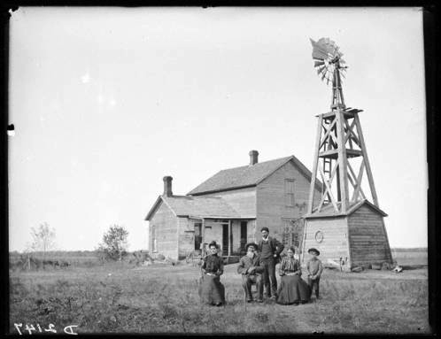
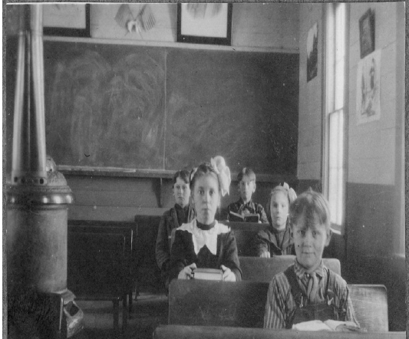
19th Century
Education
Work
7
Notes:
Industry in the 1800s was based on agriculture, cooperative small-group work, apprenticeship model in industry, hands-on piecemeal work, and apprenticeship trades.
Education in the 1800s was based on the Agrarian calendar, cooperative small-group work, and apprentice model one-room schools.
Industry and education were aligned.

Slide 8
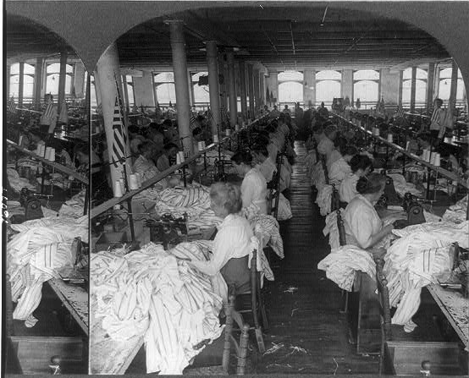
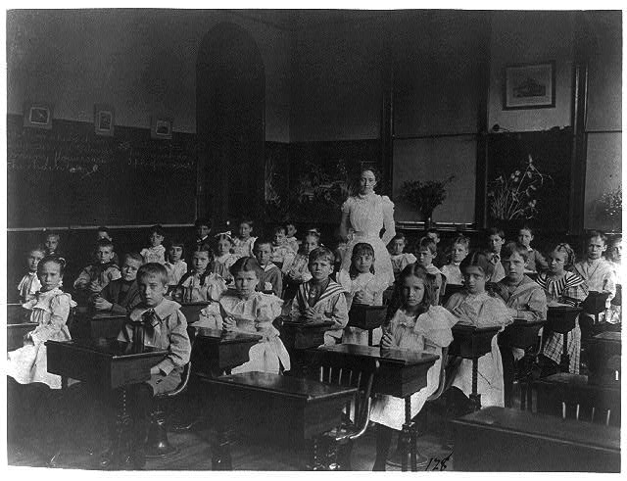
20th Century
Education
Work
8
Notes:
Early in the 20th century, industry became increasingly based on the “factory model” of manufacturing, solitary work, manager model, repetitive tasks.
Education in the 20th century was designed as a “factory school”—one size fits all, solitary work, manager model, rote memorization.
Industry and education were aligned.

Slide 9
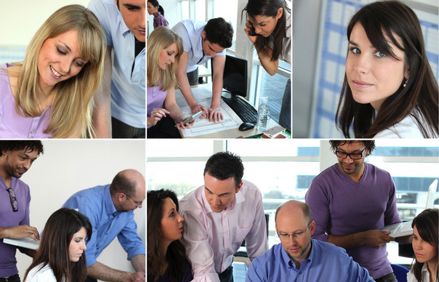
21st Century
Work
Education
9
Notes:
In the 21st century, work and industry needs have changed. Just a few examples are the impact of the Internet and digital environment creating a global anytime/anywhere workplace, international competitiveness, and the speed of innovation and change. Business and industry have transformed beyond/away from the factory model. The classroom and school model has not.
What do you think classrooms of the 21st century should look like to enable student success in this environment?

Slide 10
The Challenge
“If Rip Van Winkle woke up today, the only place he would recognize is school.”
Claudia Wallis and Sonia Steptoe,
“How to Bring Our Schools Out of the Twentieth Century”
Time, Dec. 2006
“If we give students the same educational opportunity as their parents, they will also be well-prepared for the 20th century. Let’s prepare them for the 21st century before it ends!”
Bill Daggett, President, International Center for Leadership in Education
10
Notes:
Read the challenge quotes. (2 minutes)
This slide marks the end of the first hour of training. After reading these quotes, session attendees can take a short break.
The next section of the module moves into vision development and planning for transformation.

Slide 11
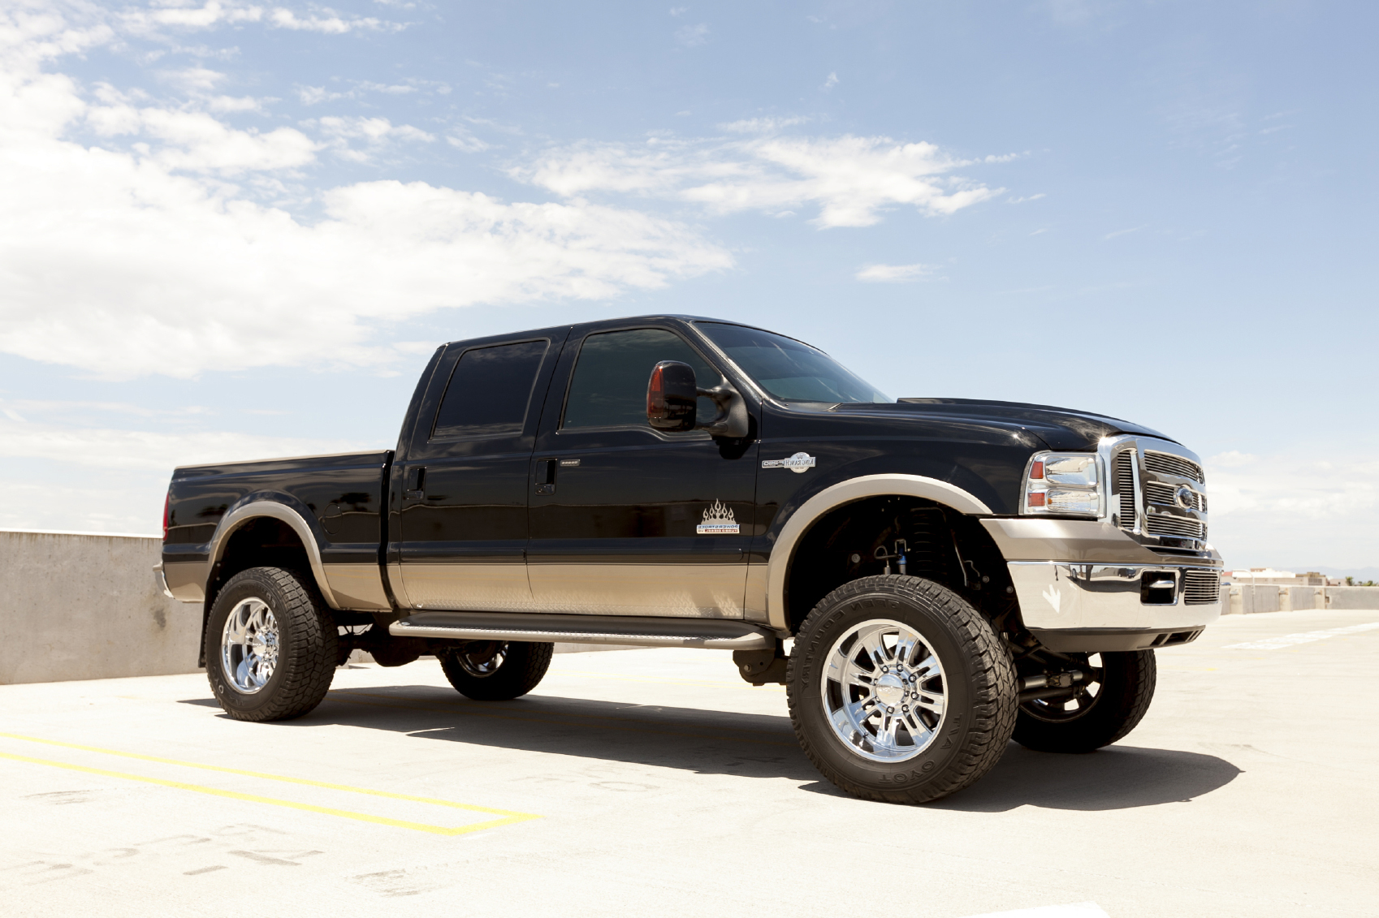
So What Do We Mean by Transformation?
CHANGE | TRANSFORMATION
11
Notes:
It is important for participants to understand the difference between change and transformation in order to understand the fundamental design work and organizational change work that is being considered in the district.
The pictured metaphor illustrates the difference between the two concepts.

Slide 12
What is School Transformation?
Transformation Is | Transformation is Not
A different way of thinking about and engaging in our work A newly designed system in response to today’s 21st century context Based on a different theory of action about how teaching and learning take place in our school Designed to prepare students to be future ready (for college, career, life choices) | A new or improved version of existing practice A reformed way to doing 20th century teaching and learning A method to fix or repair a broken system A way to get better test results on high-stakes accountability tests
12
Notes:
Share the characteristics of school transformation as contrasted to educational change or reform efforts they may have been engaged with in the past.

Slide 13
Why Transformation?
Questions for Discussion
Why should transformation take place now?
What is keeping transformation from occurring?
13
Notes:
Discuss these questions with participants.
Identify the key ideas driving and inhibiting transformation. These ideas can be recorded on chart paper for use later in the session or for leadership consideration in planning for a future transformation learning and engagement session.

Slide 14
Questions for Consideration
What might a student-centered, future-ready education system be like?
In what ways might it be different from our district today?
What steps might our district take to better prepare our students for their future?
14
Notes:
These questions provide the group an opportunity to apply these ideas about future-ready learning to the local district context.
Thinking through these issues is a long-term leadership endeavor. At this session, the group will only be able to begin the discussion. Participants can pair off to discuss and then share ideas with the whole group or process and reflect on the questions with the whole group.
(15 minutes for group dialogue)

Slide 15
What to Transform?
The learning environment?
The curriculum? The instruction?
The teacher’s role in the classroom?
The student’s role in the classroom?
School accountability policy and systems?
15
Notes:
These questions can be the focus of a deeper discussion at a later session, or this session (designed for 2 hours) can be extended.
How might we design a physical teaching and learning environment that promotes collaboration and curiosity?
How might we create an environment that inspires teachers to design engaging experiences for students that result in profound learning?
How might we create a system that ensures that students are adequately challenged and engaged?
What might the next accountability model look like that will promote and expect successful, future-ready students?
Depending on the experience level or expectations of the participants, you may prefer to have the group generate the list of what must be transformed, using an activity that elicits their responses. Activities may vary among administrator/leadership teams, board of trustees, and community members.

Slide 16
Next Steps in Transformation
16
Notes:
Inform participants that this “awareness session” is the first step in a much longer journey of learning, planning, and transformation work.
Assure the participants that school transformation doesn’t happen overnight. Rather, it comes in steps and stages over time.

Slide 17
Steps Toward Transformation
Establish the “Why?”
Study the Research
Involve Stakeholders
Administration/Leadership Teams
Board
Teacher Groups
Community
Students
Others
Develop a Plan Specific for District and Schools
Network with Others Engaged in Transformation
17
Notes:
This slide includes suggestions for a path/next steps. District leaders should communicate the path/next steps in transformation and discuss the various roles in the efforts. This slide should be revised as needed to reflect the district’s actual next steps.
If presenting to board or community members, discuss their role in supporting student-centered schools and school transformation.

Slide 18
A New Vision for Education
Creating a New Vision for Public Education in Texas
Authored by a group of Texas superintendents in 2008 after two years of research-based study in educational transformation
Created a framework for a new vision for public education
Necessary for deeper transformation discussion
18
Notes:
This session was designed to provide a rationale and historical background for the need for educational transformation as outlined in Creating a New Vision for Public Education in Texas. Published by the Texas Association of School Administrators in 2008, the vision was authored by 35 superintendents after two years of study and collaboration. The vision document is not expected to be read prior to or during this awareness session and is the focus of Module 2. At this point in the presentation, the vision document could be assigned as pre-reading for the next discussion.

Slide 19
Suggested for Study
Why Creativity Now? A Conversation with Sir Ken Robinson
Change by Design: How Design Thinking Transforms Organizations and Inspires Innovation. Brown, T.
Fastest Growing Occupations, Bureau of Labor Statistics, U.S. Department of Labor
Switch: How to Change Things When Change is Hard. Crown Publishing Group. Heath, C. and Heath, D.
Drive: The Surprising Truth About What Motivates Us. Penguin Group USA. Pink, D.
The Element: How Finding Your Passion Changes Everything. Penguin Group USA. Robinson, Sir Ken. (2009).
Creating a New Vision for Public Education in Texas. Texas Association of School Administrators. www.tasanet.org/transformation.
The Moral Imperative: From Vision to Action. Future-Ready Superintendents Leadership Institute. (2014). www.tasanet.org/transformation.
The Ever Increasing Burden on America’s Public Schools. Vollmer, J. http://www.jamievollmer.com/poster.html.
19
Notes:
Suggested articles/books for additional study to deepen understanding of the research and rationale for transformation.
Most of these texts are not included as required reading for this awareness session, but are proposed for future study.
Azzam, A. (2009). Why Creativity Now? A Conversation with Sir Ken Robinson. Educational Leadership, 67:1. Association for Supervision and Curriculum Development.
Brown, T. (2009). Change by Design: How Design Thinking Transforms Organizations and Inspires Innovation. Harper Collins Publishers.
Bureau of Labor Statistics, U.S. Department of Labor, Occupational Outlook Handbook, 2014-15 Edition, Fastest Growing Occupations. http://www.bls.gov/ooh/fastest-growing.htm
Heath, C. and Heath, D. (2010). Switch: How to Change Things When Change is Hard. Crown Publishing Group.
Pink, D. (2011). Drive: The Surprising Truth About What Motivates Us. Penguin Group USA.
Robinson, Sir Ken. (2009). The Element: How Finding Your Passion Changes Everything. Penguin Group USA.
Texas Association of School Administrators. (2008). Creating a New Vision for Public Education in Texas. www.tasanet.org/transformation.
Texas Future-Ready Superintendents Leadership Institute. (2014). The Moral Imperative: From Vision to Action. A White Paper developed for the Texas Association of School Administrators. www.tasanet.org/transformation.
Vollmer, J. (2011). The Ever Increasing Burden on America’s Public Schools. http://www.jamievollmer.com/poster.html.

Slide 20
TASA’s Transformation Tools & Supports
www.tasanet.org
One of a series of professional development modules developed by the Texas Association of School Administrators
(Module 1 adapted from a presentation of the 2013 Texas Future-Ready Superintendents Leadership Institute)
Module 1
20
Notes:
Additional resources and additional learning modules may be found on TASA’s website.

